Slide 1
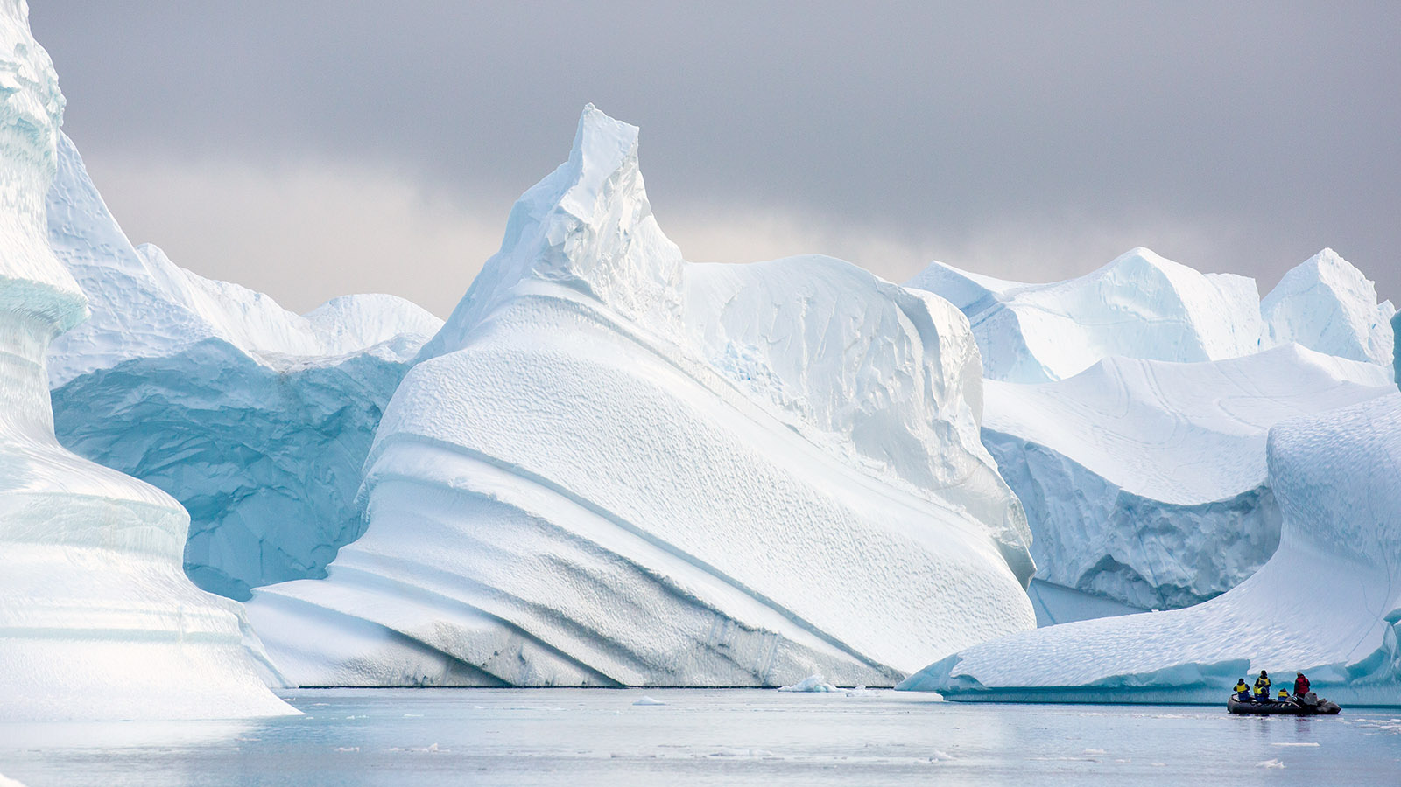
Poles Apart
Home learning wb 4-1-21
Make a list of things you need to pack for a trip to the North or South Pole. Imagine you were leading an expedition and it’s your job to write the equipment list. | Read and write a book review of your favourite book. You could write and recommendation for a friend but don’t forget to tell them ‘why’ you think they will like it. | Make a board game that can help you practise and improve your times tables.
Design a pair of snow boots. Don’t forget that you will have to make a ‘brand’ for your shoe. | Research the Artic (North Pole) and make a list of all the animals that live there. You could copy and paste them into a Word document or PowerPoint if you want. | Draw your best Polar Bear. Look on YouTube and find tutorial if you are finding it hard.
Write an advert for your snow boots. Don’t forget to use convincing phrases so that the reader is encouraged to buy your product. | Find the North and South Poles on a map. | Cook something with the adults at home that will keep you warm. Maybe something like soup which you could take on an expedition.

