Slide 1
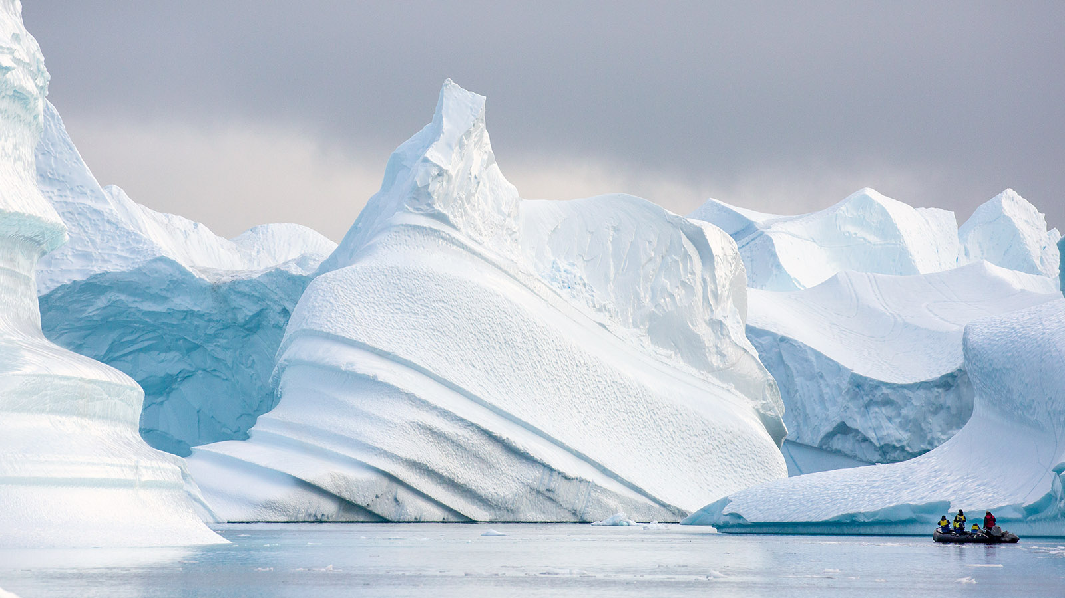
Poles Apart
Home learning wb 18-1-21
Create a comic strip where two best friends go on an Polar adventure. These main characters can be human or your favourite Polar animal. I think I would do mine using penguins, I love penguins. | Read with the adults at home. Try and pick a book you have never read and see if you can guess what is going to happen in the end. Tell your grown up. | Find out how far in miles it is from the South Pole to the North Pole. Use Google maps and see how long it would take you to drive, take the train and walk between the two.
Make a shoe box habitat for your favourite Polar animal. They could be from the South or North pole, up to you. | Use the internet, or the work you have done over the pervious two weeks, to make a list or table of different animals in the South and North Pole. Animals only in the South Pole Animals only in the North Pole | Draw or paint a Polar scene. This could be an iceberg, a mountain or the sea. Do anything you like.
Write an acrostic poem about your favourite Polar animal for example Swimming like a dart under the ice Eating delicious fish to keep them warm Acrobats in the icy blue Long flippers to help them glide through the slaty sea | At home, put three small toys into water and freeze it (make sure they are in three separate containers). When its properly frozen, choose three different ways to thaw your toys. Measure how long it take each one. For example: one is wrapped in a scarf, one is blasted with a hair dryer and the other is left at room temperature. | Write a three course menu for a Polar Bear Starter Main Pudding

