Slide 1
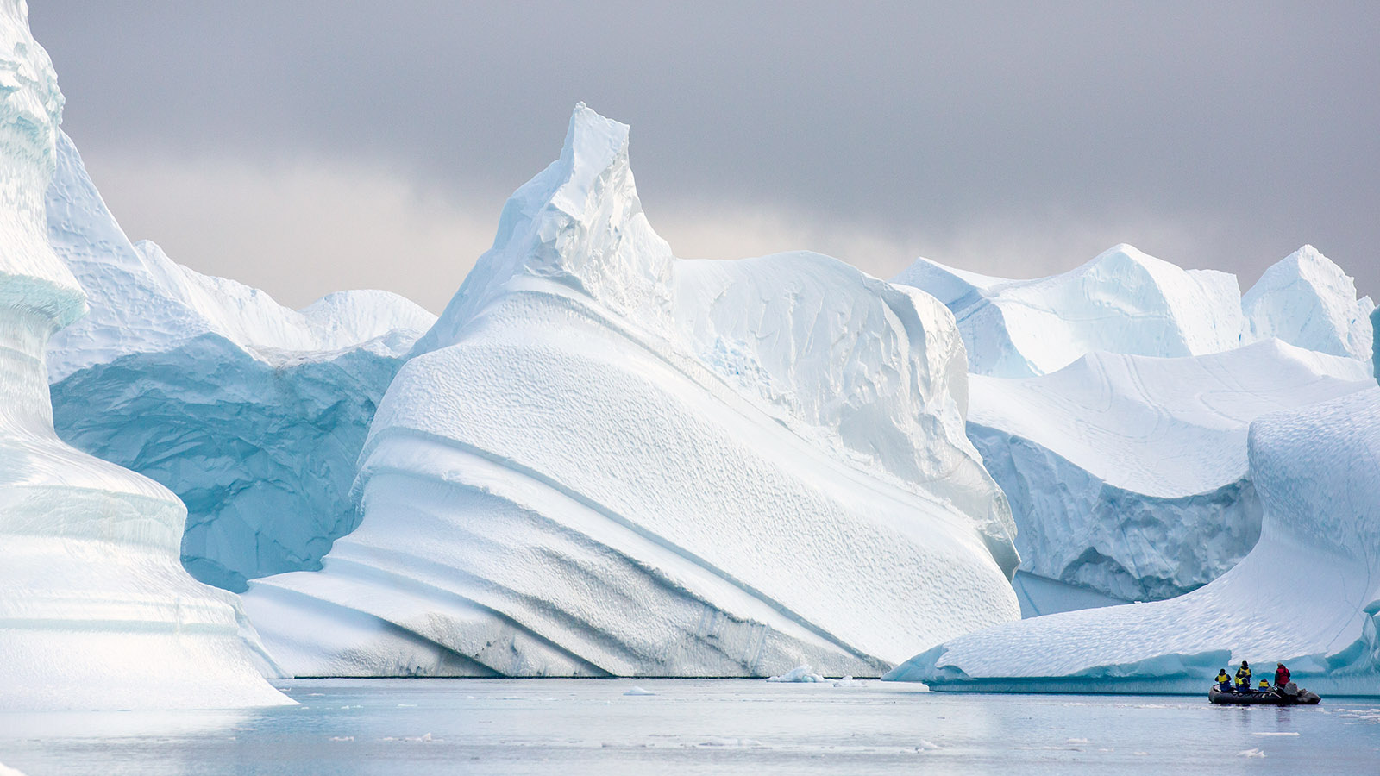
Poles Apart
Home learning wb 11-1-21
Design a front cover of a book which is set in the South Pole and you are the main character. | Read a bed time story to the adults at home. Adults love bed time stories too! | Find out how far in miles it is from your front door to the South Pole.
Design a vehicle to combat the South Pole. Don’t forget that it will need to travel across snow, ice and mountains. | Research Antarctica (South Pole) and make a list of all the animals that live there. You could copy and paste them into a Word document or PowerPoint if you want. | Draw your best Penguin. Look on YouTube and find tutorial if you are finding it hard.
Write a set of instructions on how to build you snow exploration vehicle. | Create a fact file about your favourite Antarctic animal. | See if you can design and make a cake inspired or decorated like the South Pole.

