Slide 1
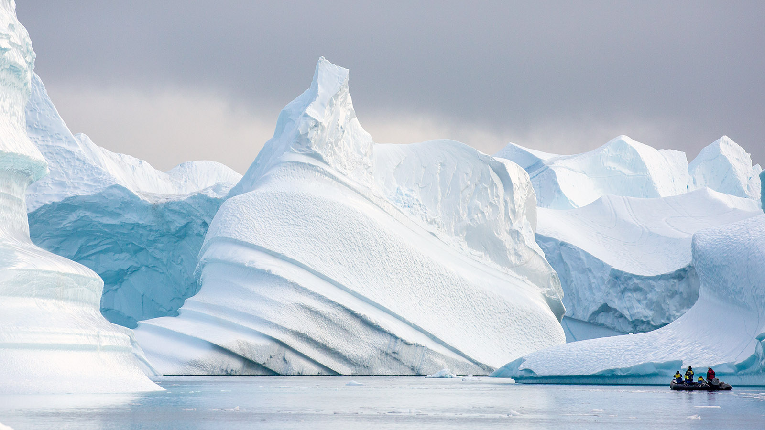
Poles Apart
Home learning wb 1-2-21
 | Write a travel brochure about the North or South Pole. Remember you are trying to sell a holiday so make sure you make it sound amazing. You could included all the day trips, animal spotting or ice hotels. | Roll a dice to generate some numbers. You can then add them together. Roll the dice to give you the number of digits that will challenge you. For example: I roll 4, 4 and 6 which could be 4+4+6 or 64+4. I could do more: 3,4,5,6,1,2 could be 3+4+5+6+1+2 or 345+612. Get an adult to help you find your level, be flexible and challenge yourself. 😃
Compare two habitats between two animals of your choice. This time pick an animal that lives in your garden (or close by) like a hedgehog or fox, and a polar animal. What’s the same what’s different? |  | Week long reading challenge. Read at least three pages a day of a book you like to an adult at home. Tick off the days when you’re done
Try and get the dolphin from S (start) to F (finish) by writing instructions. You have to keep away from the prawns. Example: Forward 1, right turn 1, forward 2 etc Or: up 1, right 2, up two, left 2 etc |  | Draw, colour and label you best compass. You must have North, South, East and West. You could include SW, SE etc
How many rectangles can you spot?
If you can’t print this out, you can draw your own.
🦑
F
🦑
🦑
🦑
M
T
W
T
F
S
S
🦑
🦑
🦑
🦑
🦑
🦑
🦑
🦑
🐬
🦑
S

